Slide 1

APBD – lecture 3
Basics of REST API
ASP.NET Core Web API

Slide 2
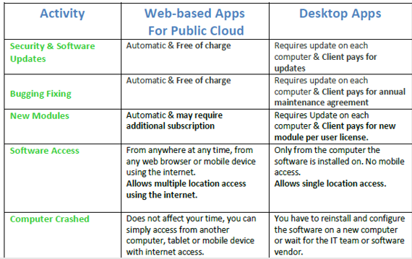
Different kind of applications

Slide 3
Rise of internet and mobile applications
Development of browsers push the development of JS language (introduction of Node.js)
Mobile systems becoming more powerful
Mobile apps, web apps, SPA (React, Angular, Vue), PWA, server-side rendered web apps
We can generally provide similar UX in web or mobile app – similar to desktop environment

Slide 4
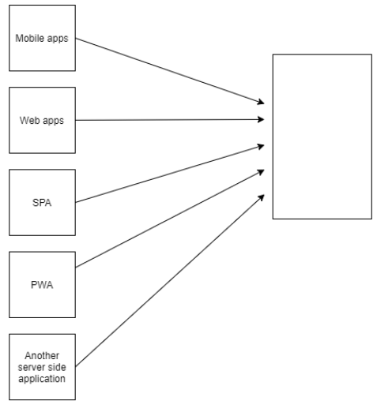
Rise of internet and mobile applications

Slide 5
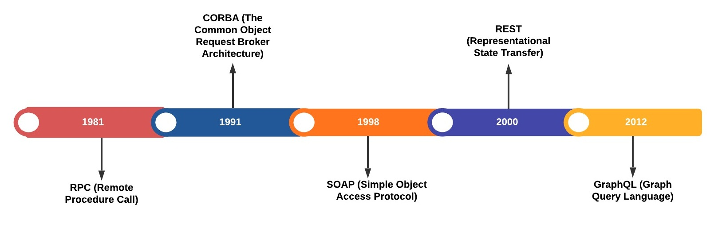
Communication between heterogeneous systems

Slide 6
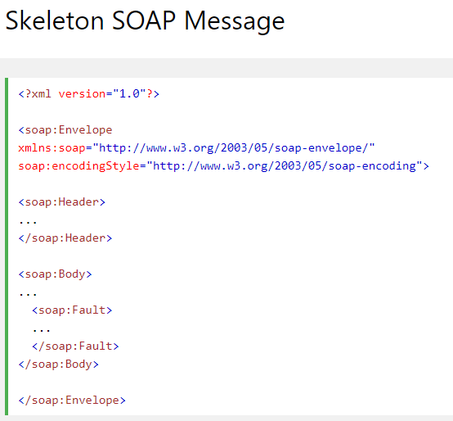
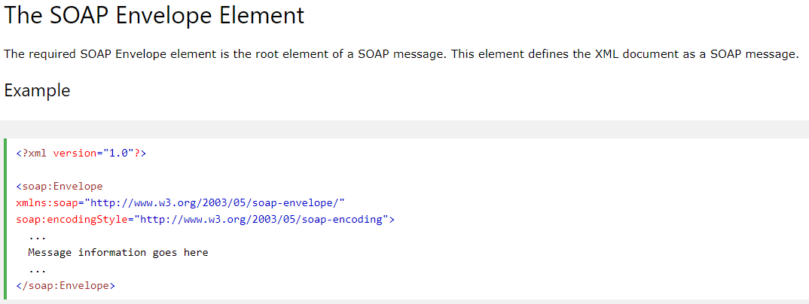
SOAP

Slide 7
REST
REST is acronym for REpresentational State Transfer. It is architectural style for distributed hypermedia systems and was first presented by Roy Fielding in 2000 in his famous dissertation.
https://www.ics.uci.edu/~fielding/pubs/dissertation/rest_arch_style.htm

Slide 8
REST
Like any other architectural style, REST also does have it’s own 6 guiding constraints which must be satisfied if an interface needs to be referred as RESTful. These principles are listed below.

Slide 9
Client–server
By separating the user interface concerns from the data storage concerns, we improve the portability of the user interface across multiple platforms and improve scalability by simplifying the server components.

Slide 10
Stateless
Each request from client to server must contain all of the information necessary to understand the request, and cannot take advantage of any stored context on the server. Session state is therefore kept entirely on the client.

Slide 11
Cacheable
Cache constraints require that the data within a response to a request be implicitly or explicitly labeled as cacheable or non-cacheable. If a response is cacheable, then a client cache is given the right to reuse that response data for later, equivalent requests.

Slide 12
Uniform interface
By applying the software engineering principle of generality to the component interface, the overall system architecture is simplified, and the visibility of interactions is improved.
In order to obtain a uniform interface, multiple architectural constraints are needed to guide the behavior of components. REST is defined by four interface constraints: identification of resources; manipulation of resources through representations; self-descriptive messages; and, hypermedia as the engine of application state.

Slide 13
Layered system
The layered system style allows an architecture to be composed of hierarchical layers by constraining component behavior such that each component cannot “see” beyond the immediate layer with which they are interacting.

Slide 14
Code on demand (optional)
REST allows client functionality to be extended by downloading and executing code in the form of applets or scripts. This simplifies clients by reducing the number of features required to be pre-implemented.

Slide 15
Resource
The key abstraction of information in REST is a resource. Any information that can be named can be a resource: a document or image, a temporal service, a collection of other resources, a non-virtual object (e.g. a person), and so on.
REST uses a resource identifier to identify the particular resource involved in an interaction between components

Slide 16
Resource
The state of the resource at any particular timestamp is known as resource representation.
A representation consists of data, metadata describing the data and hypermedia links which can help the clients in transition to the next desired state.

Slide 17
Resource
The data format of a representation is known as a media type.
https://www.iana.org/assignments/media-types/media-types.xhtml
The media type identifies a specification that defines how a representation is to be processed.
A truly RESTful API looks like hypertext. Every addressable unit of information carries an address, either explicitly (e.g., link and id attributes) or implicitly (e.g., derived from the media type definition and representation structure).

Slide 18
According to Roy Fielding:
„Hypertext (or hypermedia) means the simultaneous presentation of information and controls such that the information becomes the affordance through which the user (or automaton) obtains choices and selects actions. Remember that hypertext does not need to be HTML (or XML or JSON) on a browser. Machines can follow links when they understand the data format and relationship types.”

Slide 19
Resource
Resource representations shall be self-descriptive: the client does not need to know if a resource is employee or device. It should act on the basis of media-type associated with the resource. So in practice, you will end up creating lots of custom media-types – normally one media-type associated with one resource.

Slide 20
Resource methods
Another important thing associated with REST is resource methods to be used to perform the desired transition. A large number of people wrongly relate resource methods to HTTP GET/PUT/POST/DELETE methods.
Roy Fielding has never mentioned any recommendation around which method to be used in which condition. All he emphasizes is that it should be uniform interface. If you decide HTTP POST will be used for updating a resource – rather than most people recommend HTTP PUT – it’s alright and application interface will be RESTful.

Slide 21
REST != HTTP
REST and HTTP are not same !!

Slide 22
ASP.NET Core
ASP.NET Core is a cross-platform, high-performance, open-source framework for building modern, cloud-enabled, Internet-connected apps. With ASP.NET Core, you can:
Build web apps and services, Internet of Things (IoT) apps, and mobile backends.
Use your favorite development tools on Windows, macOS, and Linux.
Deploy to the cloud or on-premises.
Run on .NET Core.

Slide 23
ASP.NET Core web API
ASP.NET Core Web API is a platform for building web applications that use HTTP for communication. HTTP (Hypertext Transfer Protocol) is a protocol that defines the rules for transferring resources and the rules of communication between the server and the client.
ASP.NET Core Web API allows you to create APIs based on the HTTP protocol.

Slide 24
ASP.NET Core web API
This means that a Web API application can ultimately be consumed by a mobile application, web application, desktop application, SPA or IoT, or - more broadly - any application whose communication takes place via the HTTP protocol.
We will learn how to create REST-like API

Slide 25
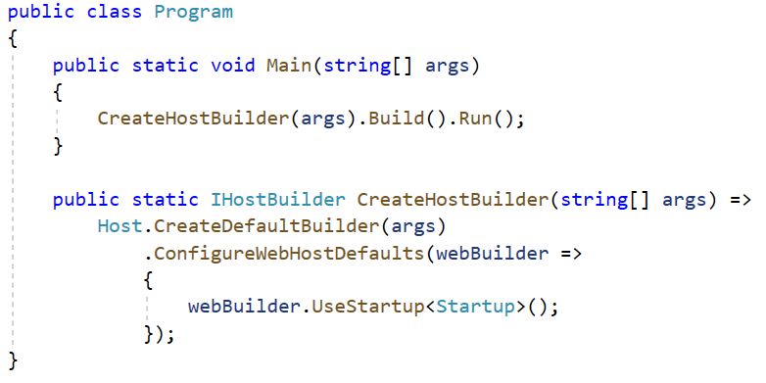
Program.cs – builder pattern
https://refactoring.guru/design-patterns/builder

Slide 26
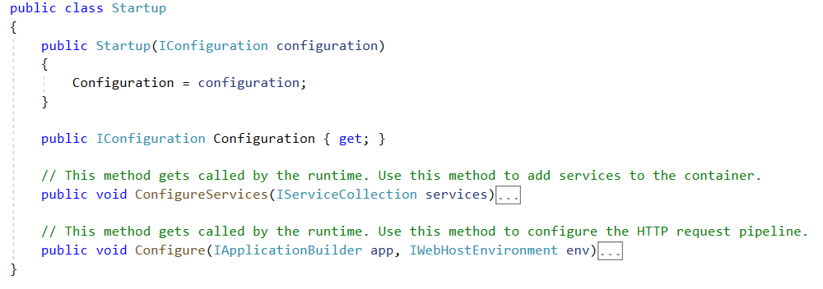
Startup.cs

Slide 27
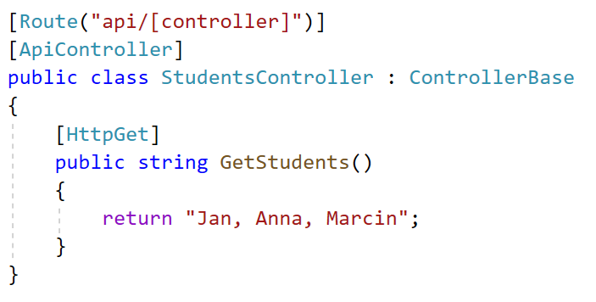
Adding custom controller

Slide 28
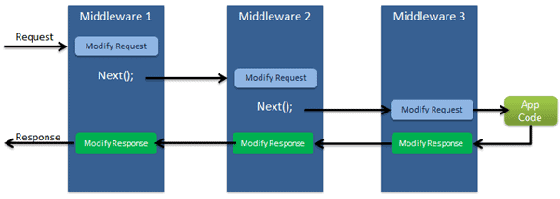
ASP.NET Core request pipeline
https://refactoring.guru/design-patterns/chain-of-responsibility

Slide 29
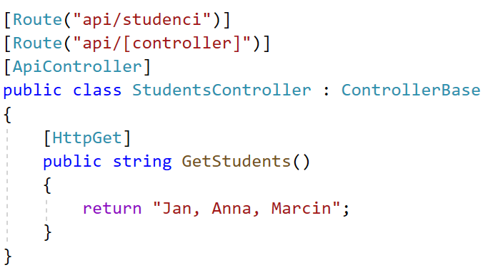
Attribute routing

Slide 30
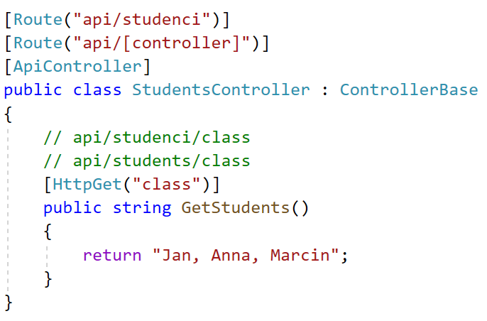
Attribute routing

Slide 31
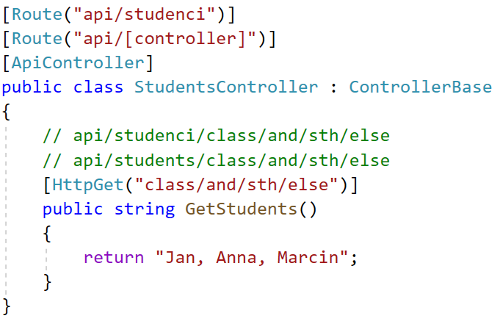
Attribute routing

Slide 32
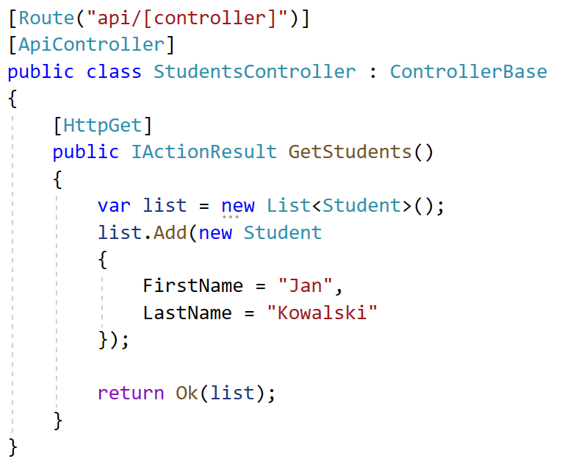
Changing the return type

Slide 33
List of HTTP status codes
1xx informational response – the request was received, continuing process
2xx successful – the request was successfully received, understood, and accepted
3xx redirection – further action needs to be taken in order to complete the request
4xx client error – the request contains bad syntax or cannot be fulfilled
5xx server error – the server failed to fulfil an apparently valid request
https://en.wikipedia.org/wiki/List_of_HTTP_status_codes

Slide 34
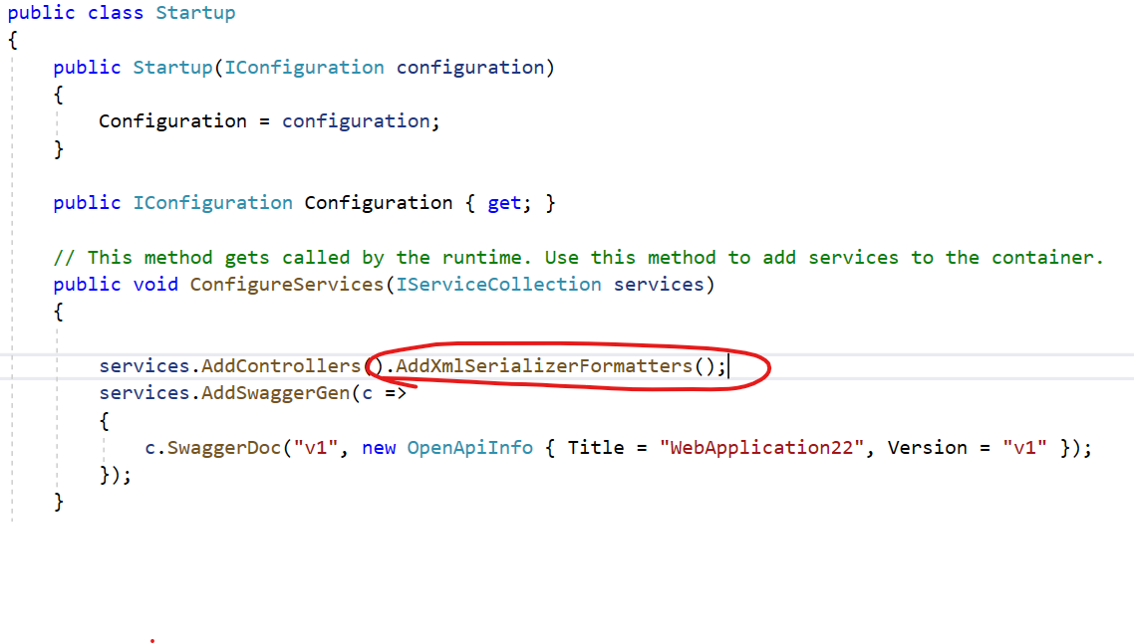
Content negotiation

Slide 35
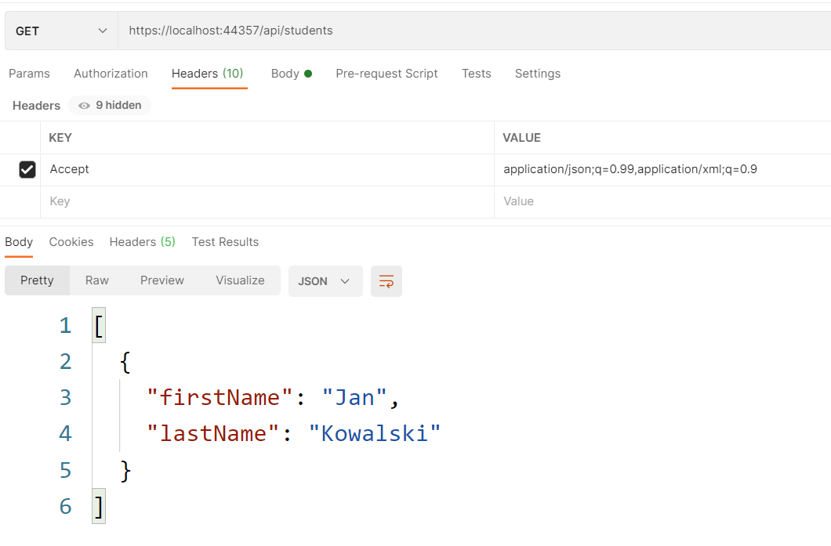
Content negotiation – Accept header

Slide 36
Endpoint design guidelines
Use nouns instead of verbs in endpoint paths
Name collections with plural nouns
Nesting resources for hierarchical objects
Handle errors gracefully and return standard error codes
Allow filtering, sorting, and pagination

Slide 37
Endpoint examples
GET /companies/3/employees should get the list of all employees from company 3
GET /companies/3/employees/45 should get the details of employee 45, which belongs to company 3
DELETE /companies/3/employees/45 should delete employee 45, which belongs to company 3
POST /companies should create a new company and return the details of the new company created

Slide 38
HTTP methods
GET method requests data from the resource and should not produce any side effect. E.g /companies/3/employees returns list of all employees from company 3.
POST method requests the server to create a resource in the database, mostly when a web form is submitted. E.g /companies/3/employees creates a new Employee of company 3.
POST is non-idempotent which means multiple requests will have different effects.
PUT method requests the server to update resource or create the resource, if it doesn’t exist. E.g. /companies/3/employees/john will request the server to update, or create if doesn’t exist, the john resource in employees collection under company 3.
PUT is idempotent which means multiple requests will have the same effects.
DELETE method requests that the resources, or its instance, should be removed from the database. E.g /companies/3/employees/john/ will request the server to delete john resource from the employees collection under the company 3.

Slide 39
Sorting, filtering, searching, pagination
Sorting In case, the client wants to get the sorted list of companies, the GET /companies endpoint should accept multiple sort params in the query. E.g GET /companies?sort=rank_asc would sort the companies by its rank in ascending order.
Filtering For filtering the dataset, we can pass various options through query params. E.g GET /companies?category=banking&location=india would filter the companies list data with the company category of Banking and where the location is India.
Searching When searching the company name in companies list the API endpoint should be GET /companies?search=Digital Mckinsey
Pagination When the dataset is too large, we divide the data set into smaller chunks, which helps in improving the performance and is easier to handle the response. Eg. GET /companies?page=23&pageSize=10 means get the list of companies on 23rd page.

Slide 40
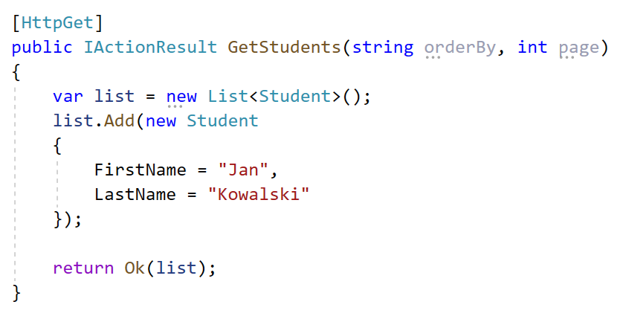
Passing data through query string
Usually used to modify, transform the resource

Slide 41
Passing data through query string

Slide 42
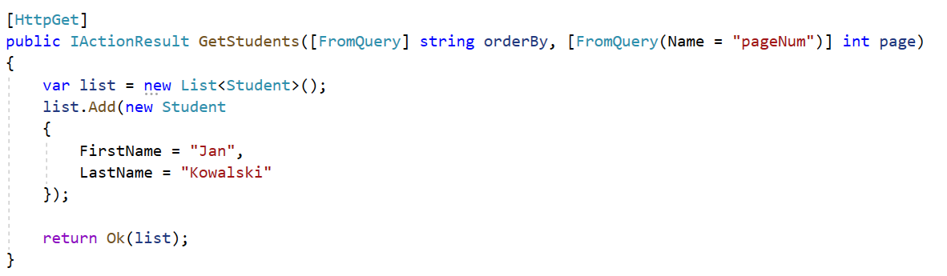
Passing data through query string – explicit declaration

Slide 43
Passing data using URL segment
path/to/page
All following elements can be considered „segments”:
path
to
page
Because they are a part of the URL we usually use them to identify a resource
Ex. api/students/s1234

Slide 44
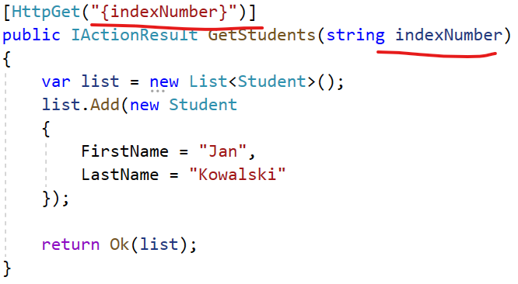

Passing data using URL segment

Slide 45
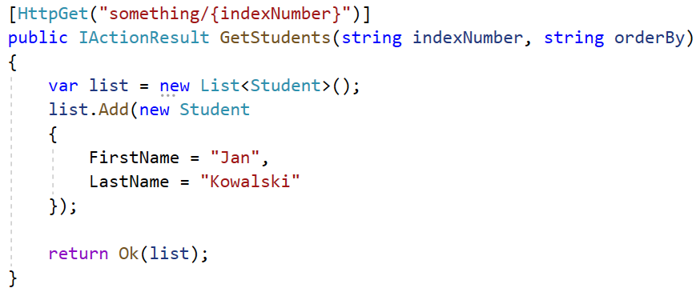
Passing data using URL segment

Slide 46
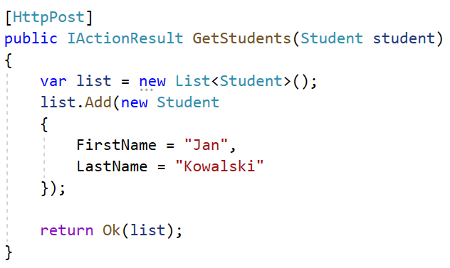
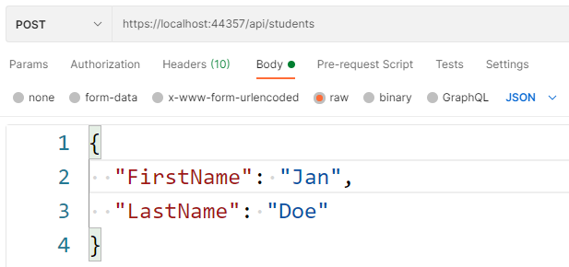
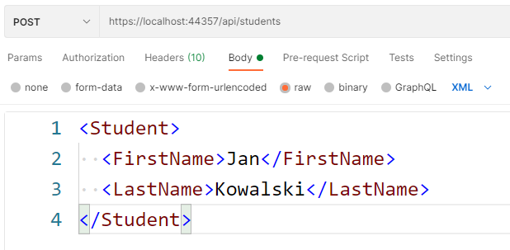
Passing data using HTTP body

Slide 47
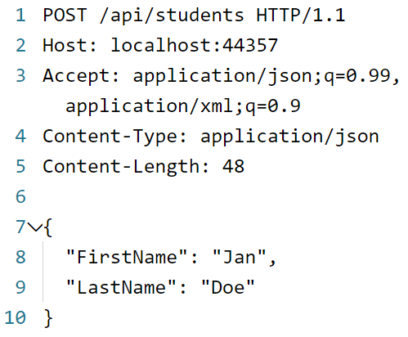
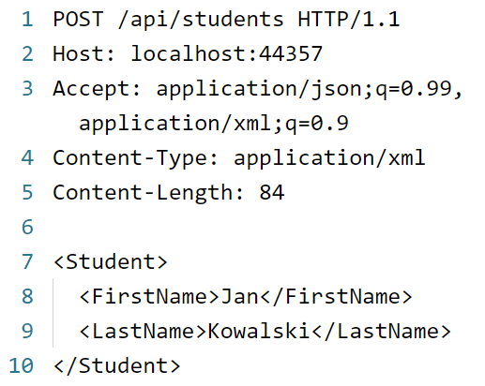

HTTP headers – Content-Type

Slide 48
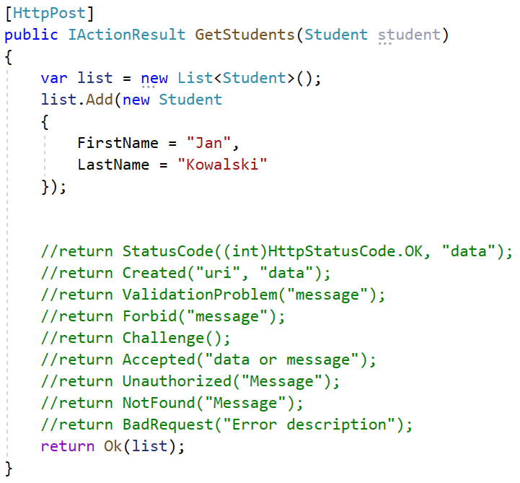
HTTP return status codes

Slide 49
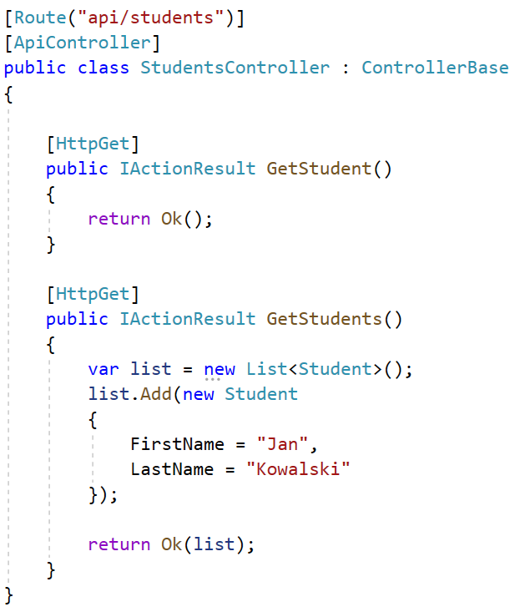
Multiple endpoints matching the same request

Slide 50
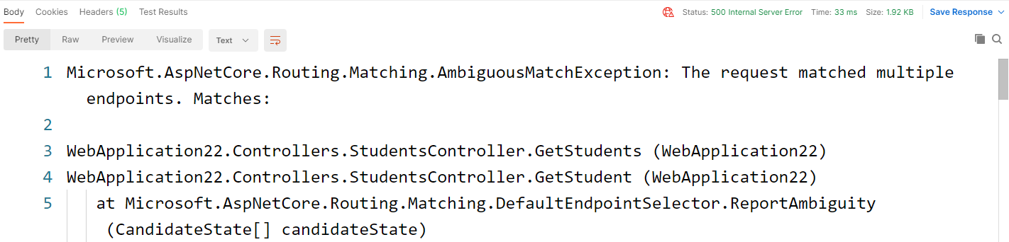
Multiple endpoints matching the same request

Slide 51
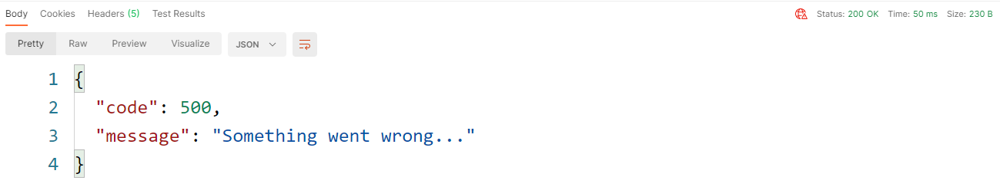
Unclear HTTP return code

Slide 52
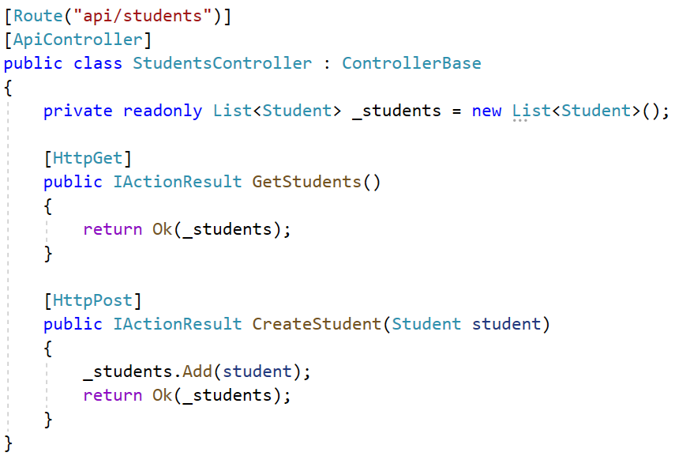
What is wrong with this code?

Slide 53
Bibliography
https://roy.gbiv.com/untangled/2008/rest-apis-must-be-hypertext-driven
https://docs.microsoft.com/pl-pl/aspnet/core/web-api/?view=aspnetcore-5.0
https://www.ics.uci.edu/~fielding/pubs/dissertation/rest_arch_style.htm
https://restfulapi.net/
https://www.merixstudio.com/blog/best-practices-rest-api-development/
https://hackernoon.com/restful-api-designing-guidelines-the-best-practices-60e1d954e7c9

